Slide 1
Sona College of Technology Department of CSE

Slide 2
Recognition of Indian Sign Language by using hand gestures and speech generation
1. Gaja Lakshmi J(1919102041)
2. Bhuvana K(1919102026)
3. Dinesh Raj V M(1919102039)
Name of the Supervisor :Prof.D.Vidyabharathi

Slide 3
Abstract
Communication with a person with hearing impairment is always a great challenge.
Disabled people with hearing loss use sign language as a means of communicating with others.
Hand gestures are one of the ways that sign language users can communicate nonverbally.
This proposed system is the recognition of Indian Sign Language (ISL) in real time based on hand gestures and generate the speech output for the recognized text.
The purpose of this work is to develop a system that can recognize hand gestures in real time using computer vision and then we train the model to create the appropriate character, words, or sentences for the identified sign.
In order to enhance communication between the person with hearing impairment and the blind, this technology also offers voice output for the created text.
Additionally, this system offers the text to sign language generation paradigm, which permits two-way communication without the use of a translator.

Slide 4
Introduction
Sign language is an essential means of communication for hearing impaired people to communicate with one another.
Problem occur when communication between people with hearing disability and normal people who doesn’t understand sign language.
This Indian Sign Language Recognition(SLR) system helps to translate the sign language hand gesture in real time.

Slide 5
Objective
The main objective of this project is to help the hearing impaired people to communicate with normal people by using this automatic sign language recognition system with text and speech generation.
The aim of this project is to recognize the hand gesture in real time and predict the corresponding alphabets, words and sentences for Indian sign language.

Slide 6
Scope
This scope of this system is that normal people can communicate with hearing impaired people without the knowledge of sign language and without the help of translator.
This sign language hand gesture to text/speech system can be used in specific public domains such as airports, hospitals, government offices etc,...
This sign language recognition system can help to translate the real-time hand gesture to text/speech enables inter-communication between normal and hearing impaired people.

Slide 7
Literature Review
 | Author, Paper Title & Journal Name, Year | Methods/Technique/Algorithm | Dataset, Advantages/Applications | Limitations
1. | Bambang Krismono Triwijoyo, Lalu Yuda Rahmani Karnaen, Ahmat Adil, Deep Learning Approach For Sign Language Recognition, Journal Ilmiah Teknik Elektro Komputer dan Informatika(JITEKI), Jan-2023 | Seven-layer Convolutional Neural Network(CNN) | ASL dataset,accuracy-99%,image processing using background correction improved model performance | Performance of model is strongly influenced by the specification of web cam and lighting system.
2. | Ahmed Kasapbasi, Ahmed Eltayeb, Ahmed Elbushra, Omar Al-Hardanee, Arif Yilmaz, DeepASLR: A CNN based human computer interface for American Sign Language recognition for hearing-impaired individuals, ELSEVIER-Computer Methods and Programs in Biomedicine Update, dec-2021 | Convolutional Neural Network(CNN) | ASL dataset, accuracy-99.38% | More images needed to improve accuracy and reduce loss

Slide 8
Literature Review (Cont..)
 | Author, Paper Title & Journal Name, Year | Methods/Technique/Algorithm | Dataset, Advantages/Applications | Limitations
3. | Mehreen Hurroo, Mohammad Elham Walizad, Sign Language Recognition System using Convolutional Neural Network and Computer Vision, International Journal of Engineering Research & Technology (IJERT), dec-2020 | Uses CNN of 3 layers with ReLu, 2D CNN with tensor flow library | ASL Dataset with 10 alphabets, accuracy-90%, used in real-time for sign language recognition | Model is trained only for 10 alphabets.
4. | Dushyant Kumar Singh, 3D-CNN based Dynamic Gesture Recognition for Indian Sign Language Modeling, 5th International Conference on AI in Computational Linguistics, 2021 | 3D Convolutional Neural Network | 20 ISL words,accuracy-88%, helps in reducing problems faced while communicating with deaf and dumb people. | Model trained for only 20 words, absence of speech generation, low accuracy

Slide 9
Literature Review (Cont..)
 | Author, Paper Title & Journal Name, Year | Methods/Technique/Algorithm | Dataset, Advantages/Applications | Limitations
5. | Amrita Thakur, Pujan Budhathoki, Sarmila Upreti, Shirish Shrestha, Subarna Shakya, Real time sign language recognition and speech generation, Journal of innovative image processing, 2020 | CNN, VGG-16 model | ASL dataset,accuracy-99.65%,can be used as learning tool for beginners | Lack of generating basic words
6. | Rachana Patil1, Vivek Patil1, Abhishek Bahuguna1, and Mr. Gaurav Datkhile1, Indian sign language recognition using convolutional neural network, ITM Web of Conferences, 2021 | Computer Vision techniques such as gray-scale, dilation and mask operation, CNN | ISL dataset(1-10 digits), accuracy-95%, used for effective human machine interaction | Dataset consists of only digits and the model is trained only for recognizing digits.

Slide 10
Literature Review (Cont..)
 | Author, Paper Title & Journal Name, Year | Methods/Technique/Algorithm | Dataset, Advantages/Applications | Limitations
7. | Shagun Katoch, Varsha Singh, Uma Shanker Tiwary, Indian Sign Language Recognition System using SURF with SVM and CNN, ELSEVIER-Array, 2022 | SURF, Support Vector Machine(SVM), CNN | ISL dataset, SVM accuracy-99.17%, CNN accuracy-99.64% | Causes delay in response on live video stream
8. | Satwik Ram Kodandaram, N Pavan Kumar Sunil G L, Sign Language Recognition, Turkish Journal of Computer and Mathematics Education, Aug-2021 | Ensemble model(LeNet-5, MobileNetV2, Own Model, Ensemble model | ASL(26 alphabets,0-9 digits, space, delete, Nothing), accuracy- 99.8% | Failed to cover other dynamic gestures except alphabets(A-Z) and digits(0-9)

Slide 11
Literature Review (Cont..)
 | Author, Paper Title & Journal Name, Year | Methods/Technique/Algorithm | Dataset, Advantages/Applications | Limitations
9. | Fayed F. M. Ghaleb, Ebrahim A. Youness, Mahmoud Elmezain, Fatma Sh. Dewdar, Vision-Based Hand Gesture Spotting and Recognition Using CRF and SVM, Journal of Software Engineering and Applications, 2015 | Human Computer Interaction, Conditional Random Fields, Support Vector Machine | Digits Dataset(0-9), accuracy- 92.50% | Trained for only recognizing digits
10. | Sharvani Srivastava, Amisha Gangwar, Richa Mishra, Sudhakar Singh, Sign Language Recognition System using TensorFlow Object Detection API, International Conference on Advanced Network Technologies and Intelligent Computing (ANTIC-2021), 2021 | Tensorflow object detection API | ISL(26 alphabets, each 25 images), accuracy-85.45% | Trained only for 26 alphabets with only 650 images.

Slide 12
Summary of Literature
There exists numerous sign language recognition system for American sign language(ASL).
Those existing systems identifies only single alphabetical character or digit(only few identifies all 26 alphabets).
The existing systems doesn’t have the feature of speech generation for Indian sign language(ISL) system.
There exists only one-way communication system(i.e, sign language to text) for ISL.
There exists both vision based and sensor based model for hand gesture based sign language recognition system.

Slide 13
Proposed work
The proposed sign language recognition system is for Indian sign language which uses double handed gesture.
This proposed system can generate characters, words and sentences.
This ISLR(Indian Sign Language Recognition) system includes speech generation.

Slide 14
Proposed work (Cont..)
This proposed system allows two way communication system(sign to text and text to sign) along with speech output.
The proposed system uses all alphabetical characters and digits for sign language recognition.

Slide 15
Novelty in Proposed Work
This proposed system includes two way communication for Indian sign language system.
It also includes generation of words and sentences.
It also includes speech output for generated texts.

Slide 16
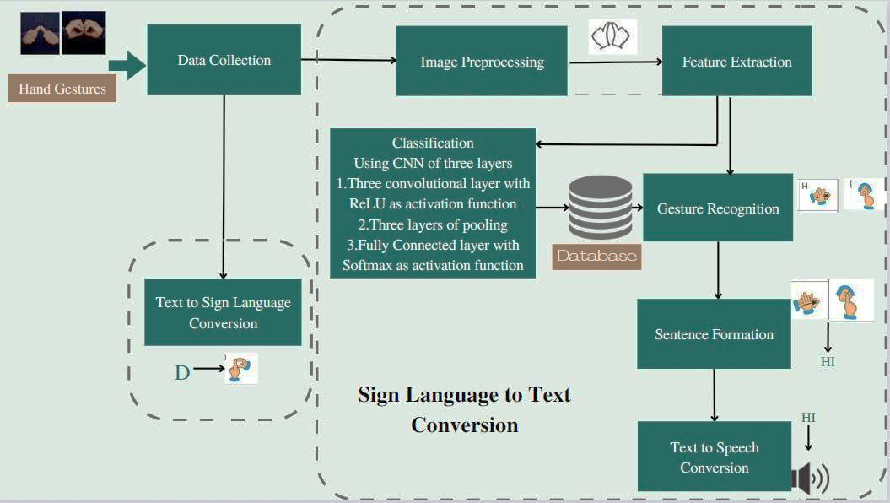
Work Flow Diagram/Block Diagram

Slide 17
Algorithms / Techniques
A CNN based model is developed for training the image dataset to classify the images of hand gestures with high accuracy.
CNNs are a type of deep neural network that can automatically learn and extract features from images.
First, extract the features of a picture using OpenCV, then apply the Gaussian blur filter and threshold to the frame.
In order to predict words, this processed image is given to the proposed CNN based model. If a letter is found during the timeframe, the letter is printed and taken into consideration for forming the word.
To create a sentence, the blank image is used to insert spaces.

Slide 18
Modules
Data Collection
Image Preprocessing
Training
Gesture recognition
Sentence formation
Voice generation
Text to Sign Conversion

Slide 19
Data Collection
The Proposed system uses the custom data set that consists of images of hand gestures for Indian Sign Language.
The Images are captured using web cam and labeled corresponding to the hand gestures.
The Custom Dataset consists of 36 classes that includes alphabets(A-Z), Numbers(1-9).

Slide 20
Data preprocessing
First, the input image is converted to grayscale to extract the important features of the hand gesture.
Next, the grayscale image is then blurred using a Gaussian filter to lessen noise and smoothen the edges of the hand region .
Finally, the hand region is then separated from the background using thresholding.

Slide 21
Training
In training phase, the proposed ISLR system uses CNN based proposed model.
Three convolutional layers with ReLU activation functions, followed by max pooling layers, a flatten layer, and a fully connected layer with a SoftMax activation function make up the proposed CNN architecture for ISLR utilizing hand gestures.
Adam optimizer is used to improve the accuracy and reduce the loss.
The proposed model is trained for 5 epochs and achieves an accuracy of 95%.

Slide 22
Gesture Recognition
After training the model, the hand gesture is captured in real time using OpenCV.
The captured image is then preprocessed and loaded into the trained model.
The trained CNN based model will predict the class(A-Z,1-9) to which the hand gesture belongs.
Once the model predicts the shown hand gesture, it will display the name of the predicted hand gesture.
Then the predicted text is displayed in sequence to form words and sentence.

Slide 23
Speech Generation
To enhance the communication between the hearing impaired and the people with vision loss, the proposed system includes the feature of converting the text to speech using python text to speech technology.

Slide 24
Text to Sign
The proposed system includes the additional feature of displaying the hand gesture for the text provide by user to enable two-way communication.

Slide 25
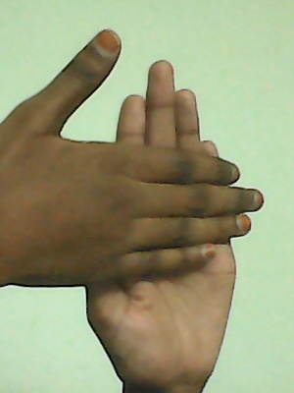
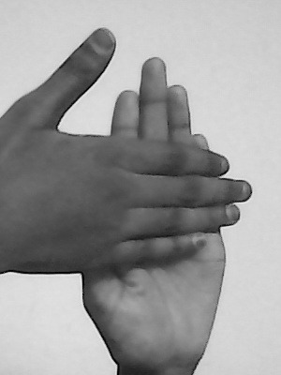
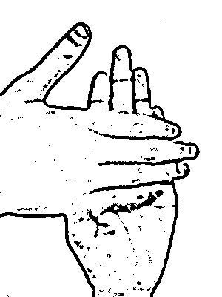
Preprocessing Results obtained (ScreenShots)
After applying gaussian blur filter
Raw Image
Gray Scale Conversion

Slide 26
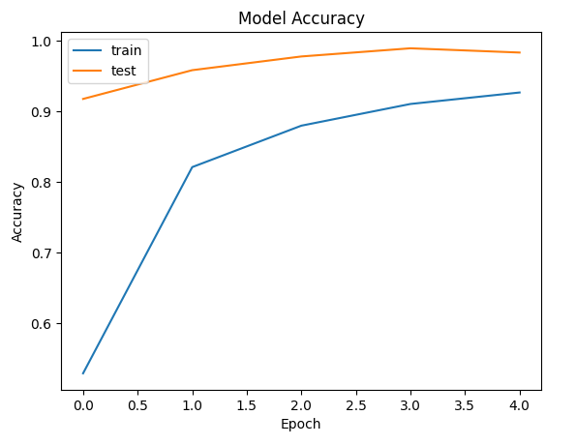
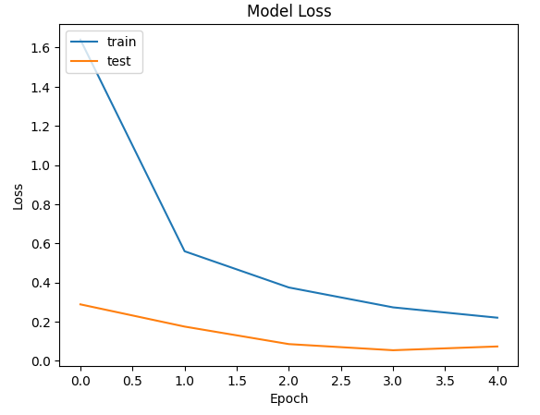
Results obtained
Screenshots
After training the proposed CNN model for 5 epoch, we achieved the accuracy of 95%.

Slide 27
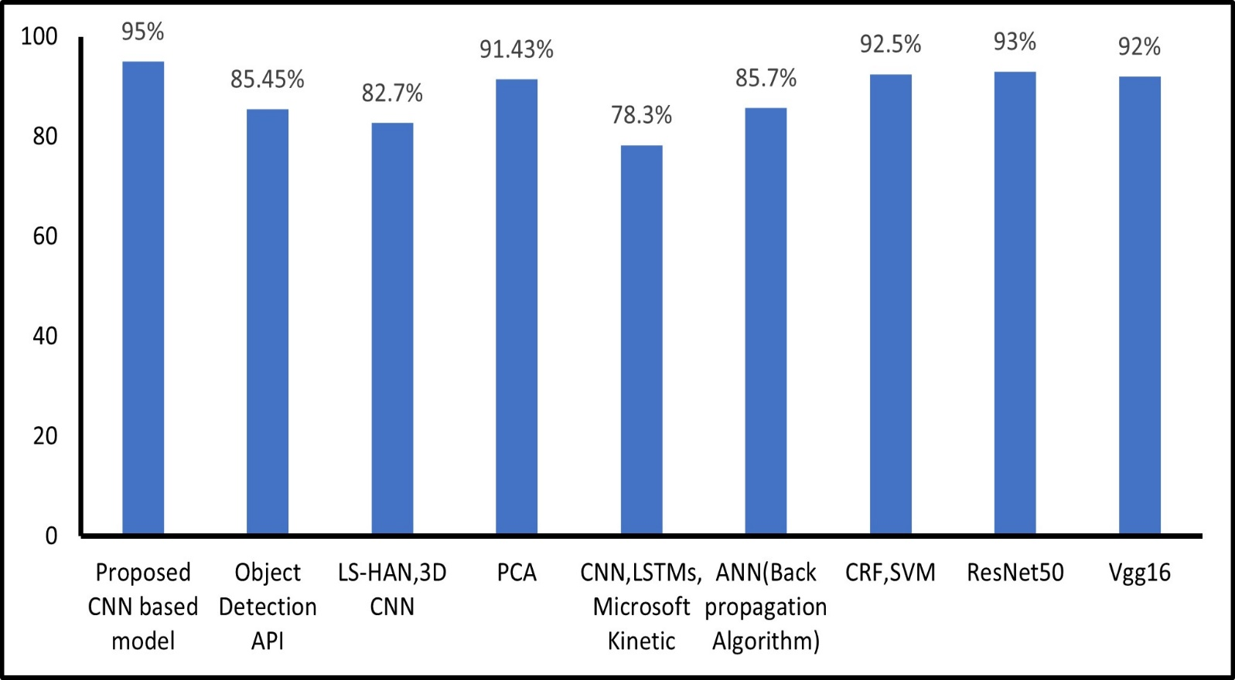
Model Comparisons

Slide 28
References
Triwijoyo, Bambang & Karnaen, Ahmat & Adil, Ahmat. (2023). Deep Learning Approach For Sign Language Recognition. 9. 12-21. 10.26555/jiteki.v9i1.25051.
KASAPBAŞI, Ahmed & Elbushra, Ahmed & AL-HARDANEE, Omar & YILMAZ, Arif. (2022). DeepASLR: A CNN based Human Computer Interface for American Sign Language Recognition for Hearing-Impaired Individuals. Computer Methods and Programs in Biomedicine Update. 2. 100048. 10.1016/j.cmpbup.2021.100048.
Mehreen Hurroo , Mohammad Elham, 2020, Sign Language Recognition System using Convolutional Neural Network and Computer Vision, INTERNATIONAL JOURNAL OF ENGINEERING RESEARCH & TECHNOLOGY (IJERT) Volume 09, Issue 12 (December 2020)
Singh, D.K., 2021. 3d-cnn based dynamic gesture recognition for indian sign language modeling. Procedia Computer Science, 189, pp.76-83
Thakur, Amrita & Budhathoki, Pujan & Upreti, Sarmila & Shrestha, Shirish & Shakya, Subarna. (2020). Real Time Sign Language Recognition and Speech Generation. Journal of Innovative Image Processing. 2. 65-76. 10.36548/jiip.2020.2.001.

Slide 29
References (Cont…)
Rachana Patil, Vivek Patil, Abhishek Bahuguna, Gaurav Datkhile, Indian Sign Language Recognition using Convolutional Neural Network, ITM Web Conf. 40 03004 (2021),DOI: 10.1051/itmconf/20214003004
Katoch, S., Singh, V. and Tiwary, U.S., 2022. Indian Sign Language recognition system using SURF with SVM and CNN. Array, 14, p.100141.
Kodandaram, Satwik Ram & Kumar, N. & Gl, Sunil. (2021). Sign Language Recognition. Turkish Journal of Computer and Mathematics Education (TURCOMAT). 12. 994-1009.
Ghaleb, F. , Youness, E. , Elmezain, M. and Dewdar, F. (2015) Vision-Based Hand Gesture Spotting and Recognition Using CRF and SVM. Journal of Software Engineering and Applications, 8, 313-323. doi: 10.4236/jsea.2015.87032
Srivastava, Sharvani & Gangwar, Amisha & Mishra, Richa & Singh, Sudhakar. (2022). Sign Language Recognition System Using TensorFlow Object Detection API. 10.1007/978-3-030-96040-7_48

Slide 30
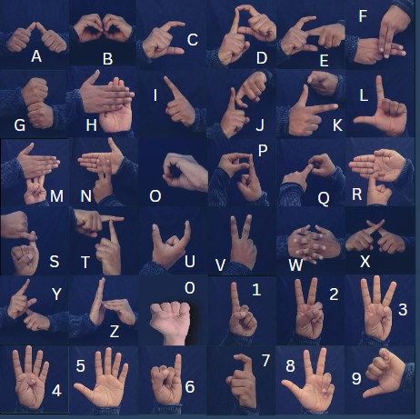
Hand Gestures

